Slide 1
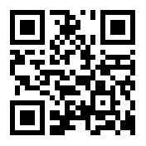
Welcome to 5th Grade
with Mrs. Anderson
www.anderson27.weebly.com
@Mrs_Anderson27
(760) 758-4934 ext: 5027

Slide 2
5th Grade Goals
Prepare students for Middle School
Develop 21st century skills: 4 Cs
collaboration, creativity, critical thinking skills, communication
Inquiry based curriculum
Develop Independency and Responsibility
Develop Organizational and Time Management Skills

Slide 3
PYP – Transdisciplinary Themes
During each year of school, students in Kindergarten (5-6 years) to Grade 5 (10-11 years) experience six different units of inquiry and spend approximately six weeks on each unit. Early Childhood (3-5 years) students experience four units of inquiry throughout each school year.
All units explore the transdisciplinary themes of:
Who We Are
Where We Are In Time and Place
How We Express Ourselves
How the World Works
How We Organize Ourselves
Sharing the Planet.
The PYP is a transdisciplinary curriculum, which draws individual disciplines together into a coherent whole, while preserving the essence of each subject.

Slide 4
Scheduling
Daily Inquiry into:
Mathematics
English/Language Arts
Two week Morning Rotation - Sessions of:
History with Mrs. Lieu
Writing with Grammar with Mrs. Anderson
News Crew Writing with Mrs. Cerelli
English Language Development (ELD) with Mrs. Young
Two week Afternoon Rotation – Sessions of:
STEM with Mrs. Anderson or Mrs. Lieu
Science with Mrs. Young or Mrs. Cerelli

Slide 5
Scheduling

Slide 6
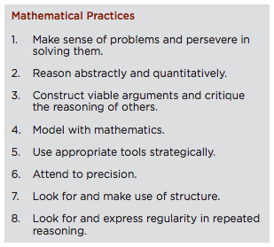
Common Core Math
The Common Core is a set of standards to guide students to be ready for careers and colleges.
It aims to provide problem solving opportunities so that students can be critical thinkers. Here is a set of guidelines in math provided from the Common Core.

Slide 7
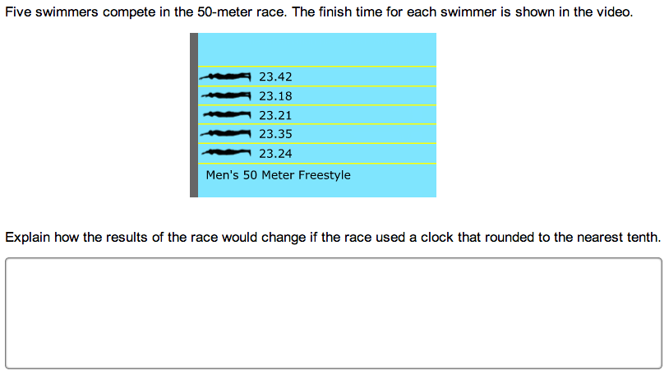
Common Core Math Ex.
Before:
Now:

Slide 8
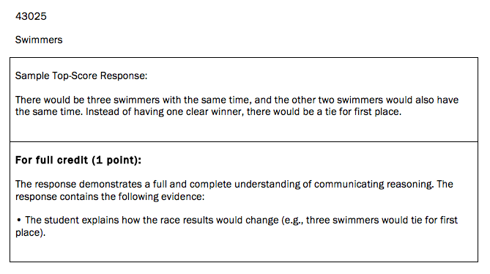
Common Core Math Ex.
Before:
Now:

Slide 9
Math
Flipped Math – Video Studies at home
A challenged based and performance based curriculum.
Cornell notes
Number Talk

Slide 10
Reading
“Reading is to the mind what exercise is to the body.”
AR Organs – Incentives
Wide Choice of Print
Fiction and Non-Fiction Books
Articles
Digital Media
Reciprocal Teaching – Predicting/Inferring, Questioning, Clarifying, and Summarizing

Slide 11
STEM projects
Our year is divided into 6 units of inquiry followed by 6 major projects:
Sharing the Planet
Engineering
Who We Are
Operation Casita
How We Express Ourselves
CSI: Casita – Forensic Science with Courtroom Simulation
How the World Works
Weather Broadcast
How We Organize Ourselves
Architecture - in Anderville, Lieuside, and Youngista
Where We Are In Time and Place
Shark Tank

Slide 12
Homework and Behavior

Slide 13
A classroom without walls
Field Trips
Channel 10 News Station (Weather Broadcast) – Afterschool
Legoland
WAVE water park (Safeties only)
Ocean Institute at Dana Point
Virtual Field Trips
Forensic Science with Rice University
Video Conferences
Physicians or Physician’s Assistants (PAs) – Operation Casita
Civil Engineers – Engineering

Slide 14
Assessments: How do I know how my child is doing?
We use a balanced range of assessment tools and strategies, carefully designed to give students and parents a clear picture of a student’s progress. Some of these strategies are:
Observations
Performance assessments such as presentations, debates, and rubrics.
Teacher-student/student-student conferences and conversations
Tests with true/false, multiple-choice questions
Open-ended tasks such as written answers and drawing illustrations and diagrams.
Some of the assessment tools are:
Rubrics: student and/or teacher-designed criteria
Benchmarks
Checklists
Anecdotal records: brief written notes based on observations of students

Slide 15
BYOD: Bring Your Own Devices
We are a 21st Century Classroom and strongly encourage students to BYOD (Bring your own devices). Students will be using them to access information on the web as well as through other apps.
Android and iPad/iPhone/iPod Apps:
Google Drive
Haiku Deck (iPad only)
Show Me (iPad only)
QR reader
TEDx

Slide 16
Parental Support @home: How do I help my child at home?
There are many ways in which 5th Grade parents can support their children’s learning, including:
Ensure that your child completes their homework
Discuss the unit of inquiry
Discuss the profiles and attitudes that are being worked on
Read daily with your child or encourage and see to it that they read 30 minutes a night.
Visit the local library
Encourage independence, organizational and time management skills
Encourage math concepts in everyday life (ex: when cooking/shopping) and practice times tables
Play games together (ex: Scrabble, Challenge 24, Sudoku)
Write diaries, poems, stories together
Seek advice from school.

Slide 17
Parental Support @school: How do I help my child at school?
Have time off and would like to help in the classroom or take items home to complete?
Please complete the parent volunteer sheet so we can work out a schedule or a time where you can help out.
THANK YOU in advance!

Slide 18
After School Activities
There is a wide selection of after-school activities and clubs for our students to join. Details of our activities program are sent out at the beginning of each club/activity and are subject to change according to demand and interests.
5th Grade at Casita Center, the range of activities includes:
Drama advised by Ms. Rias
Student Council by Mrs. Hoffman
Garden Club by Mrs. Becky
Safety Patrol by Mr. Perez
Star Party by Mr. Brown
Track Team by Mr. Brown and other teachers
Scrabble Club by Mrs. Countryman
Challenge 24 by Mrs. Lieu and Mrs. Anderson
IB club by Ms. Seabrook

Slide 19
What should be expected from our PYP - PBL class?
Student-centered learning with the teacher as the guide/facilitator
Students engaged in their learning in different areas of the classroom
Students working in groups, individually or as a whole class
Students may be involved in different activities within the same session as they pursue their own inquiries
Collaboration (student-student/student-teacher/student-visitor)
Action – students extending their learning independently
Opportunities for students to try out their ideas and abandon or modify their misconceptions (learning by experience)
Evidence of student learning around the classroom
A literature rich environment stocked with fiction and non-fiction texts
Lots of language on display
Children explaining to themselves and to others the big ideas behind their learning
Hands-on resources such as science equipment, computers, games, math tools.

