Slide 1
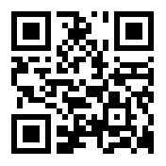
Welcome to 5th Grade
with Mrs. Anderson
www.anderson27.weebly.com
@Mrs_Anderson27
(760) 758-4934 ext: 5027

Slide 2
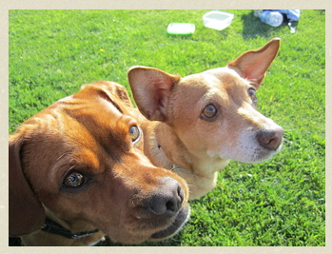
About Mrs. Anderson
Teaching – 6 years
Graduated from University of California, San Diego (UCSD
Ms. Chien
Two dogs: Tako and Albert
I enjoy cooking but for the
most part, I love eating. Love it!

Slide 3
Goals
5th Grade is all about preparing the students for middle school.
Common Core through 21st century competencies (4 Cs)
collaboration, creativity, critical thinking skills, communication
Responsibility
Independence
How to THINK!

Slide 4
Scheduling
Daily Inquiry into:
Mathematics
English/Language Arts
Two week Morning Rotation - Sessions of:
History with Mrs. Lieu
Writing with Grammar with Mrs. Anderson
News Crew Writing with Mrs. Cerelli
English Language Development (ELD) with Mrs. Young
Two week Afternoon Rotation – Sessions of:
STEM with Mrs. Anderson or Mrs. Cerelli
Science with Mrs. Dorward or Mrs. Young

Slide 5
Math
Flipped Math – Video Studies at home
A challenged based and performance based curriculum.
Cornell notes
Number Talk

Slide 6
Reading
“Reading is to the mind what exercise is to the body.”
AR Organs – Incentives
Wide Choice of Print
Fiction and Non-Fiction Books
Articles
Digital Media
Reciprocal Teaching – Predicting/Inferring, Questioning, Clarifying, and Summarizing

Slide 7
STEM projects
Our year is divided into 6 units of inquiry followed by 6 major projects:
How the World Works
Engineering
Who We Are
Operation Casita
How We Express Ourselves
CSI: Casita – Forensic Science with Courtroom Simulation
How We Organize Ourselves
Architecture - in Anderville, Lieuside, and Youngista
Where We Are In Time and Place
Weather Broadcast
Sharing the Planet.
Shark Tank

Slide 8
BYOD: Bring Your Own Devices
We are a 21st Century Classroom and strongly encourage students to BYOD (Bring your own devices). Students will be using them to access information on the web as well as through other apps.
Android and iPad/iPhone/iPod Apps:
Google Drive
Haiku Deck (iPad only)
Show Me (iPad only)
QR reader
TEDx

Slide 9
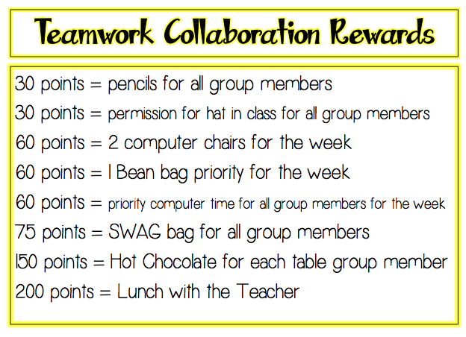
Teamwork Collaboration

Slide 10
Individual Behavior

Slide 11
Individual Homework

Slide 12
After School Activities
There is a wide selection of after-school activities and clubs for our students to join. Details of our activities program are sent out at the beginning of each club/activity and are subject to change according to demand and interests.
5th Grade at Casita Center, the range of activities includes:
Drama advised by Ms. Rias
Student Council by Mrs. Hoffman
Garden Club by Mrs. Becky
Safety Patrol by Mr. Perez
Star Party by Mr. Brown
Track Team by Mr. Brown and other teachers
Scrabble Club by Mrs. Countryman
Challenge 24 by Mrs. Lieu and Mrs. Anderson
IB club by Ms. Seabrook

